Slide 1
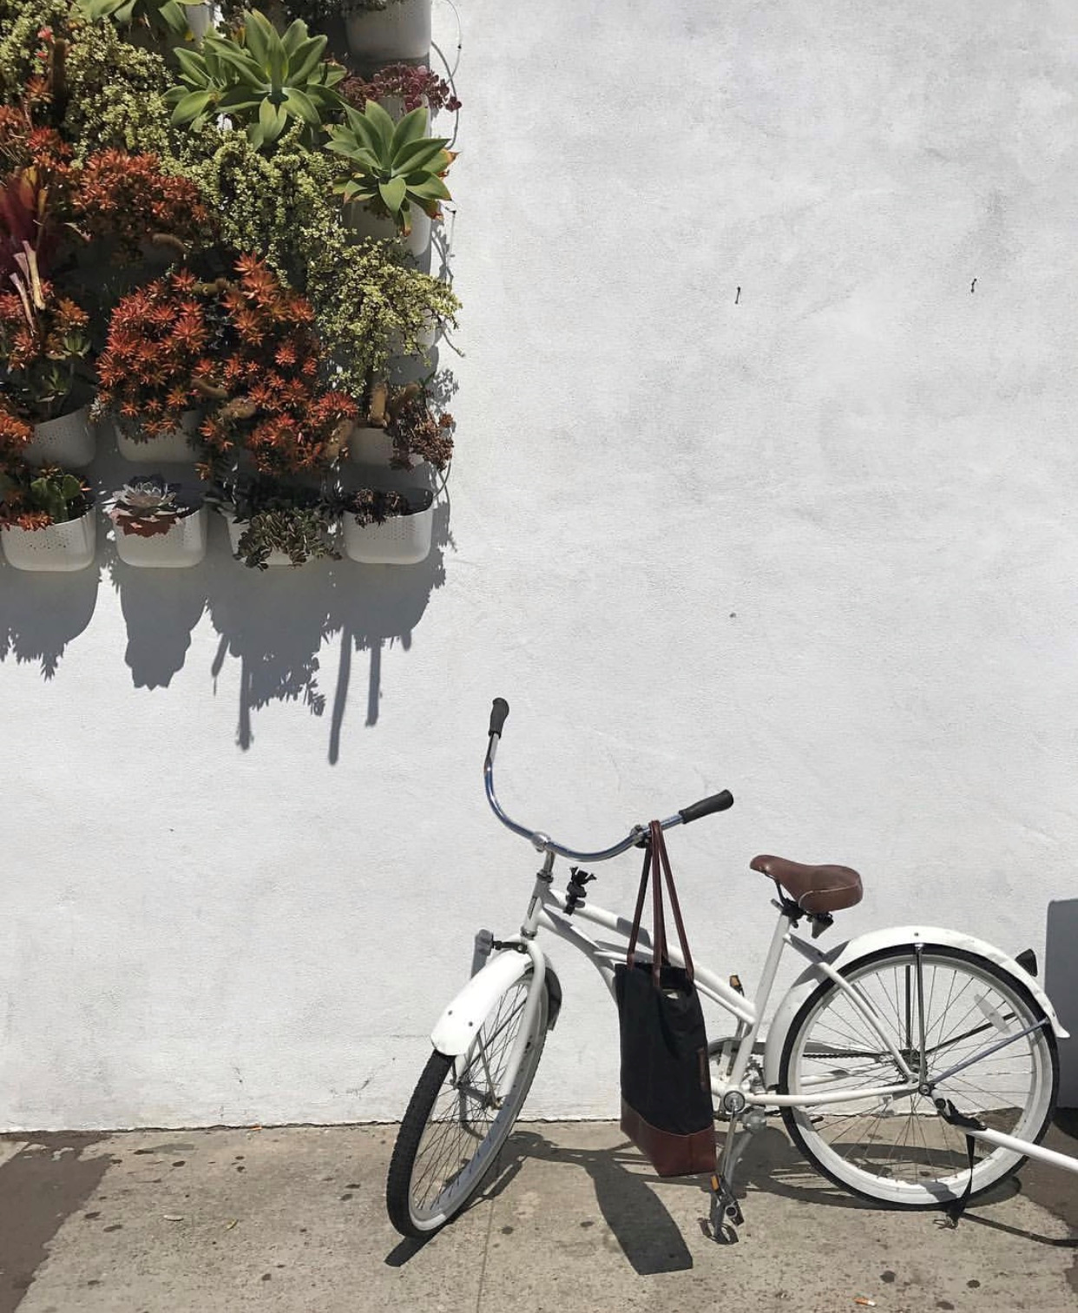

Slide 2
2020 Milestones
0420
COVID Forces Change
Closed facility in NC and two retail stores due to Covid-19. Rerouted production to Florida facility as essential business
Volunteer Nation
0320
Launched a volunteer nation of over 500 volunteers making and donating masks during PPE shortage
Open Doors
0120
0720
QVC TSV
0820
D2C Fulfillment
Open Doors in new facility in Wauchula, FL.
Completed Today’s Special Value for QVC.
Record production 12,500 Units Sold out by 11:00AM
Brining Fulfillment to Wauchula for additional job creation.
Previously outsourced
Job Creation
0620
0720
OEM
Mid-year on track to meet
job creation goals
Contract manufacturing begins
19
60
RR243
Krista, Riveter RR243, stops by
Facility to meet sewing operators

Slide 3
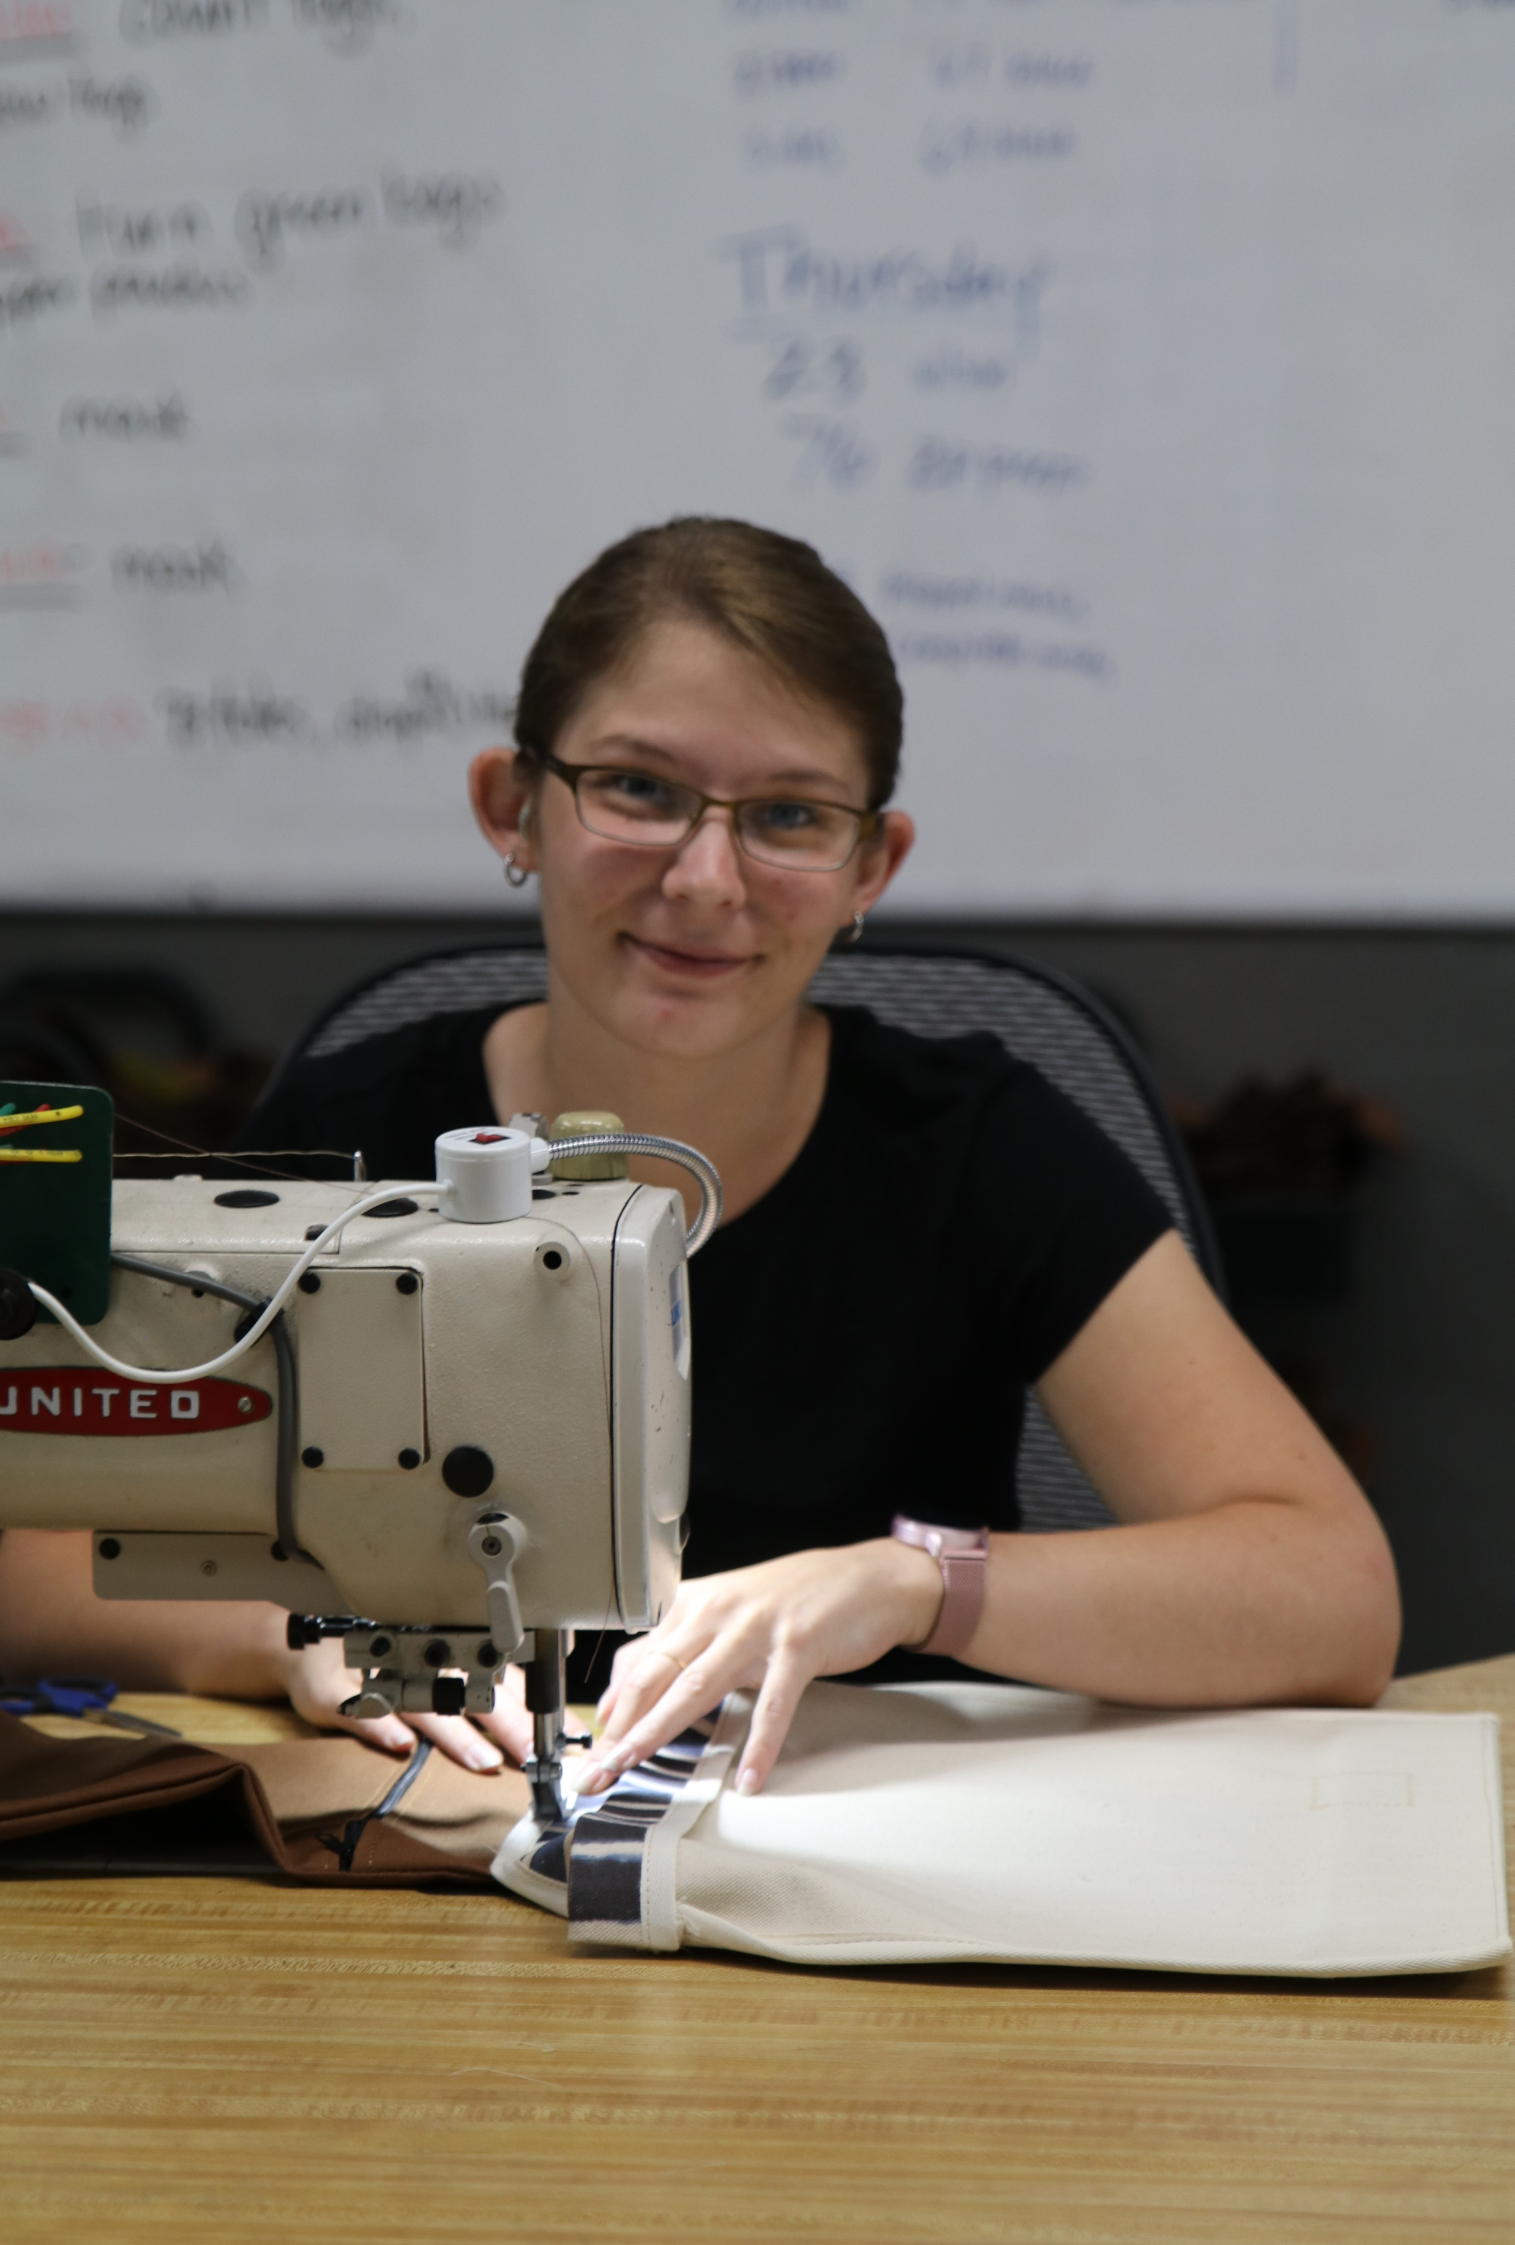
FTE JOB CREATION
2020 Job Creation FTE Minimum: 16
Currently: 28 Employees
25 Full-time – 3 Part-time employees
Year Average – 20 FTEs
25,000 Hours – Non salaried employees

Slide 4
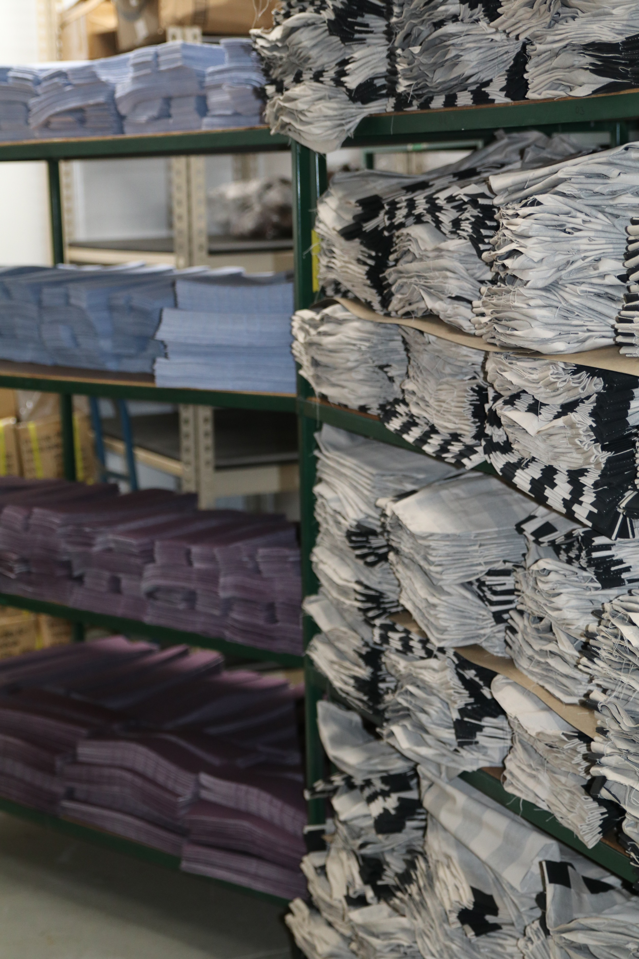
Foundational Year
Streamlined Riveter Process
Increased Production Capacity
Expanding Our Mission – American Manufacturing

Slide 5
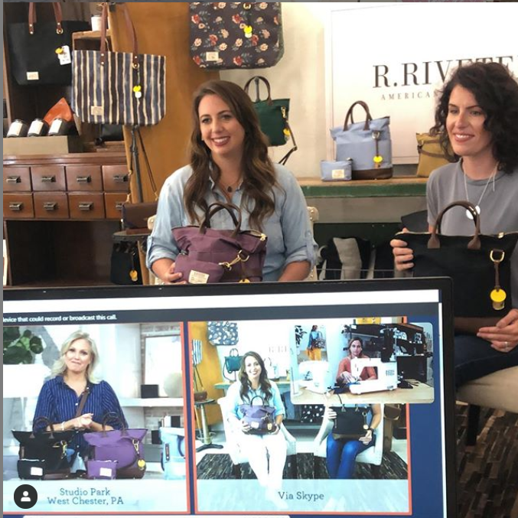
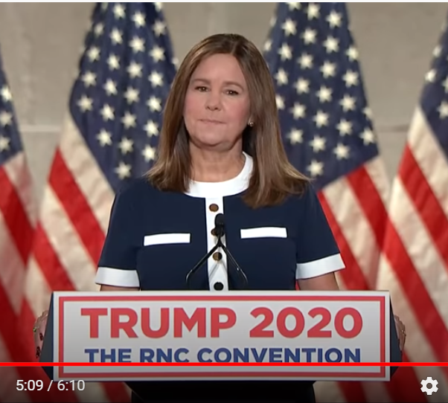
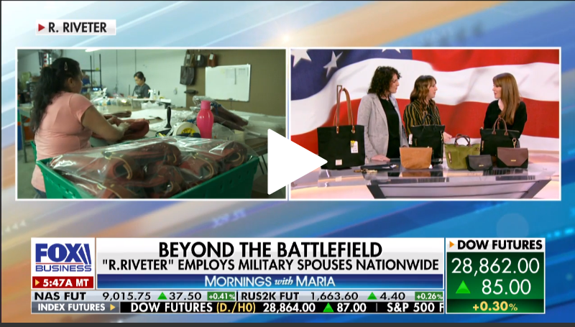
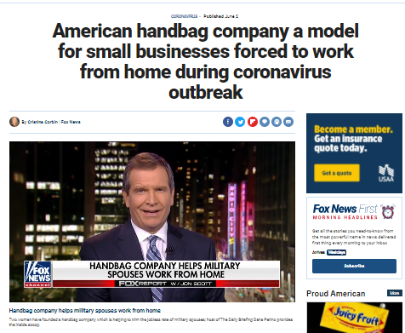
High Impact | 2020
06
20
07
20
08
20
01
20
MORNINGS WITH MARIA
FOXNEWS.COM
QVC
Mrs. Pence
June 6, 2020
Highlighting Covid Efforts
Todays Special Value.
Republic National Convention Mention - highlighting efforts towards military spouse unemployment.
January 13, 2020
Highlighting Job Creation Grant In Hardee County

Slide 7
Construction
Mission Statement
Our intentions for this space are simple. We aim to curate a space that tells a story–showcasing the past, present and future of our brand and the community we call home. The Riveter story has always been rooted in the spirit of the maker.
The soul of buildings and the character of Main Street will be celebrated - allowing the customer to experience our brand in an unprecedented way. We will develop a space that brings the community together, celebrating authenticity and pride in American manufacturing. This space, like our brand, will feature authentic details and a foundation which is rooted in tradition put in place by those who came before us.

Slide 8
Studio Sewing Room Glass wall for Viewing
Light Beach House Store
E x t e r i o r
Glass wall for Viewing

Slide 9
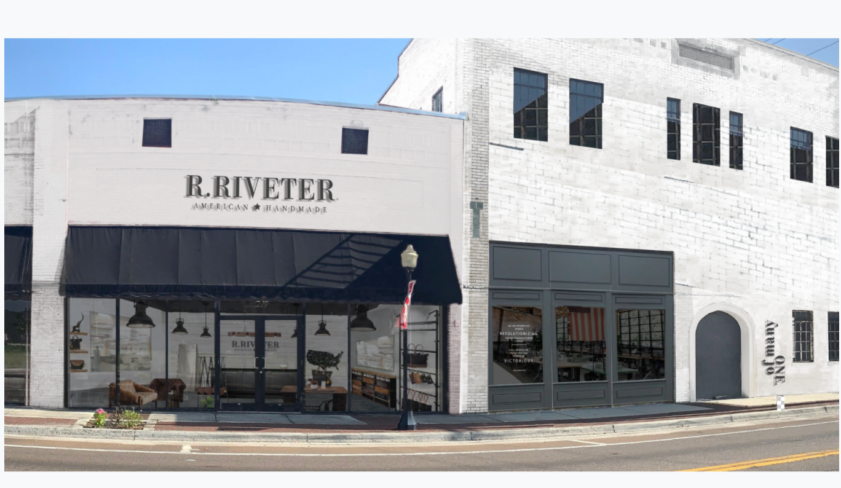

Slide 10
